Slide 1
Establishing peer support workers as members of a community based clinical outreach team
Service User Academia Conference 2018
Melbourne, Victoria
Gabrielle Vilic
Director, Social Inclusion and Recovery
Metro South Addiction and Mental Health Services
Metro South Hospital and Health Service

Slide 2
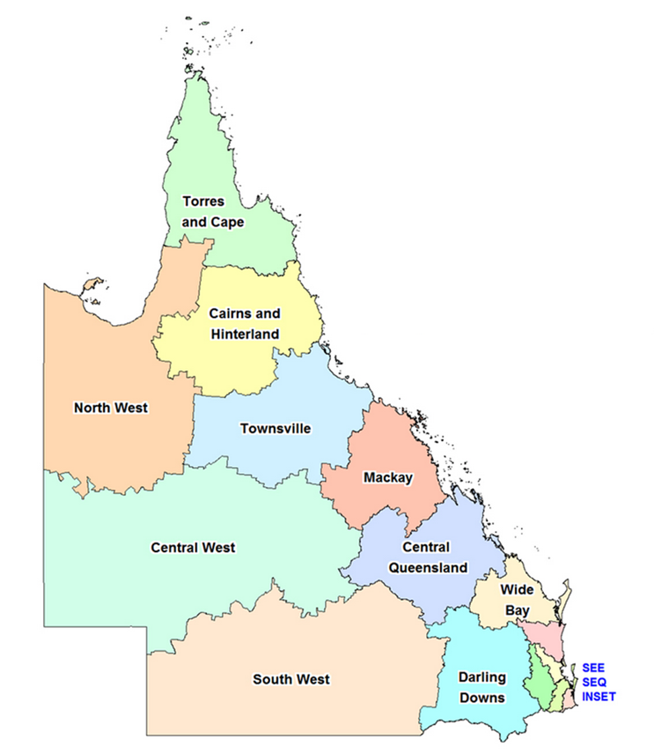
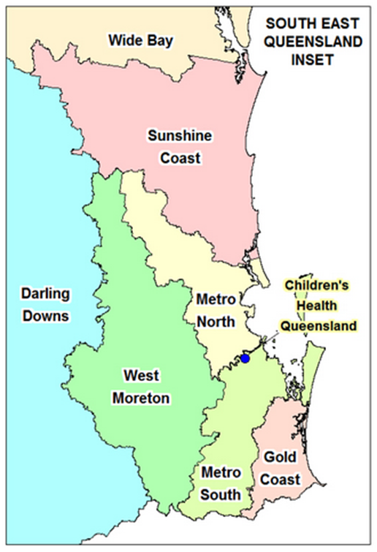

Slide 3
Peer support workers:
have a lived experience of mental health and/or addiction issues
be able to draw on their lived experience to support others
(highly desirable) have completed relevant training in either:
Certificate IV in Mental Health
Certificate IV in Mental Health Peer Work
Certificate IV in Community Services
or can demonstrate their commitment to undertaking these studies
possess the necessary attitudes, skills, knowledge and behaviours to undertake the role effectively.

Slide 4
Purpose of the Logan-Beaudesert Wellbeing Team
Intensive support to those patients who:
frequently present to the Emergency Department
are regular/long-term inpatient admissions
Both inpatient and community supports
Build and promote linkages with local community organisations
Recreation
Socialisation
Support for daily living skills and activities

Slide 5
Logan-Beaudesert Wellbeing Team – Peer Support Workforce
2015
General Adult x 1FTE
Youth and Families x 1FTE
Culturally and Linguistically Diverse (CALD) x 2FTE
Aboriginal and Torres Strait Islander (ATSI) x 1FTE
Maori and Pacific Islander (MPI) x 1FTE
Supports in place
Orientation
Operational supervision (Line manager)
Professional/Reflective Practice supervision (monthly)
Training and professional development opportunities
Performance Coaching Sessions (known as PAD process)

Slide 6
Interviews
Commencement of employment
Six months after employment
Peer support workers
Complex work
Learning how to work in a multidisciplinary team
Overwhelmed with the volume and breadth of work
Difficulty with establishing legitimacy within the team
Role was not understood by the clinicians
Felt stigmatised – known only by their mental distress and illness
Clinicians
Clinicians did not understand the role of peer support workers
Leant by asking about their diagnosis, rather than their strengths and skills
Stigma
Perceived interference with the therapeutic alliance

Slide 7
Interviews
Peer support workers:
Able to broker relationships with patients and families
Needed to find their voice – strong clinical
Patients trusted peer support workers
Patients would accept clinical advice if peer support workers said they could be trusted
Peer support workers assisted patients to navigate recovery
Peer support worker role was flexible and could cross into care spaces that clinicians could not:
Acute care
Non government community based care
Acute care staff welcomed peer support workers in ways they could not with clinicians

Slide 8
Structure of the Logan-Beaudesert Wellbeing Team – Peer Support Workforce
2018
General adult x 1 Perm FTE
CALD x 1 Perm FTE (reduced from 2 FTE)
ATSI x 1 Perm FTE
MPI x 1 FTE
Youth and Families - increased
Youth peer support workers x 1 Temp FTE (2 x 0.5)
Carer peer support worker x 1 Temp FTE (0.5)
Pay structure
Administrative stream
Pay rates vary between $32.19 - $42.07 per hour
Casual rates are 23% higher again
Penalty rates for after hours or shift work

Slide 9
Thank you
For further information, please contact
Gabrielle Vilic
Director, Social Inclusion and recovery
Metro South Addictions and Mental Health Services
T: 07 3156 9812
E: Gabrielle.Vilic@heath.qld.gov.au
Website: https://metrosouth.health.qld.gov.au/mental-health

