Slide 1
NEW ZEALAND POLICE TRAINING PROGRAMME
Jeremy Tumoana – WoD Service User Team, Otago University

Slide 2
World of Difference Service user research group
Education programmes contributing to ending discrimination and promoting recovery, inclusion and respect for the human rights of people who experience mental distress, led and delivered by experts with personal experience.
“We live in a world where we are treated differently - disabled by prejudice, discrimination and social exclusion in response to our experiences of mental distress. Our ultimate goal is to contribute to creating a different world - one where our experiences of mental distress are recognised and respected as an element of natural human difference and diversity, and are NO barrier to us being able to experience recovery, inclusion, and to exercise our human rights on an equal basis with all others: a World of Difference that will make the World of Difference to those of us who experience mental distress.”
Dr Sarah Gordon

Slide 3
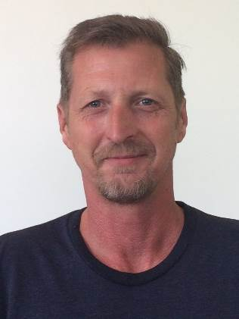
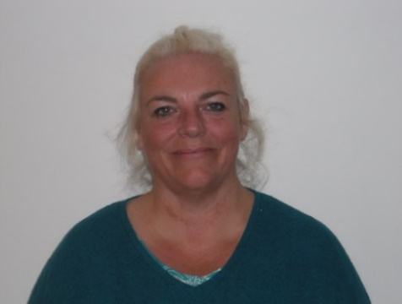
World of Difference – Introducing some of the Facilitator team….
Scott Savidge
I do this work as part of my recovery and because I believe my experience has value. It's an opportunity to engage with people who will soon be in positions of power, and to remind them of their responsibility to our shared humanity.
A highlight of program for me is the positive feedback from participants and the collegiality of my fellow educators.
Treena Martin
Hi, my name is Treena Martin. I am very interested in sharing my experiences to facilitate learning around mental health distress. I have been a service user since I was a teenager, and have worked in Mental Health services for twenty years. I feel passionate about influencing attitudes in a positive way.
The highlight for me about training others, is when people are given the freedom to ask questions they would not usually have the opportunity to ask.
There are so many myths about living with mental health distress. If we can stand and present our story from a place of recovery, we can give a very powerful message that recovery is possible.

Slide 4
World of Difference – Introducing some of the Facilitator team….
Suzy Stevens
I am a person who has experience of mental distress. I have been involved in educating the NZ Police recruits on helpful ways to respond to me and others if we need their help. It is very important to me that they can appreciate what I may be going through.
So far it has been great to find that the Police recruits are really receptive to us and keen to do their best and treat us with respect.
I was born in a small farming community in Southland and worked on farms and in shearing gangs after leaving school. From 1992 - 1996 I completed an apprenticeship in carpentry. I have worked as an apple picker in Central Otago, and love back country Aotearoa.
From 2012-2014 I completed a Degree in Creative Writing through Whitireia New Zealand. I am currently working on an untitled collection of poetry, which documents my mental health struggles and recovery.
I don't like the way the New Zealand media portrays mental health issues, and there is still many myths about mental health and recovery. There are many awesome people working in the mental health field, and hopefully together we can change people's perception of mental illness and recovery.
Campbell McRae

Slide 5
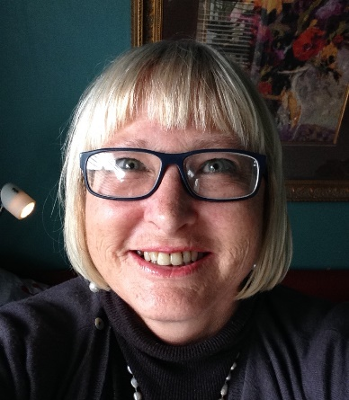
World of Difference – Introducing some of the Facilitator team….
Debs Craig
I was pleased to take up the opportunity to be a police trainer on mental distress in order to better equip police to apply empathy and understanding towards people experiencing acute mental distress, and hope that the training provides useful guidance on effective communication when involved in a 1M or a 1X callout.
A highlight has been the interest by recruits in the trainer’s personal stories of their interaction with the police (a mix of good and not so good experiences). The recruits and trainers really connect when these stories are told.
Debs Craig
I was pleased to take up the opportunity to be a police trainer on mental distress in order to better equip police to apply empathy and understanding towards people experiencing acute mental distress, and hope that the training provides useful guidance on effective communication when involved in a 1M or a 1X callout.
A highlight has been the interest by recruits in the trainer’s personal stories of their interaction with the police (a mix of good and not so good experiences). The recruits and trainers really connect when these stories are told.

Slide 6
The programmes
1. Medical students and psychiatric registrars
We have developed and extended our programme from that of a service user-led, recovery focused and contact-based education programme to a service user-led, recovery and human rights focused, contact-based education programme
We have also extended the programme to include 1st and 2nd stage, and senior psychiatric registrars in addition to 5th and 6th year undergraduate students.
2. The NZ Police Training Programme
Since 2014 the University of Otago Wellington and Kites have worked with the NZ Police to develop, deliver and evaluate service user-led education in the form of eLearning modules for staff generally and face-to-face workshops for recruits, with the aim being to counter stereotypes, prejudice and discrimination in the Police setting
The programme has been revised in response to evaluation completed in 2017 and feedback from the Police.

Slide 7
The programmes
1. Medical students and psychiatric registrars
We have developed and extended our programme from that of a service user-led, recovery focused and contact-based education programme to a service user-led, recovery and human rights focused, contact-based education programme
We have also extended the programme to include 1st and 2nd stage, and senior psychiatric registrars in addition to 5th and 6th year undergraduate students.
2. The NZ Police Training Programme
Since 2014 the University of Otago Wellington and Kites have worked with the NZ Police to develop, deliver and evaluate service user-led education in the form of eLearning modules for staff generally and face-to-face workshops for recruits, with the aim being to counter stereotypes, prejudice and discrimination in the Police setting
The programme has been revised in response to evaluation completed in 2017 and feedback from the Police.

Slide 8
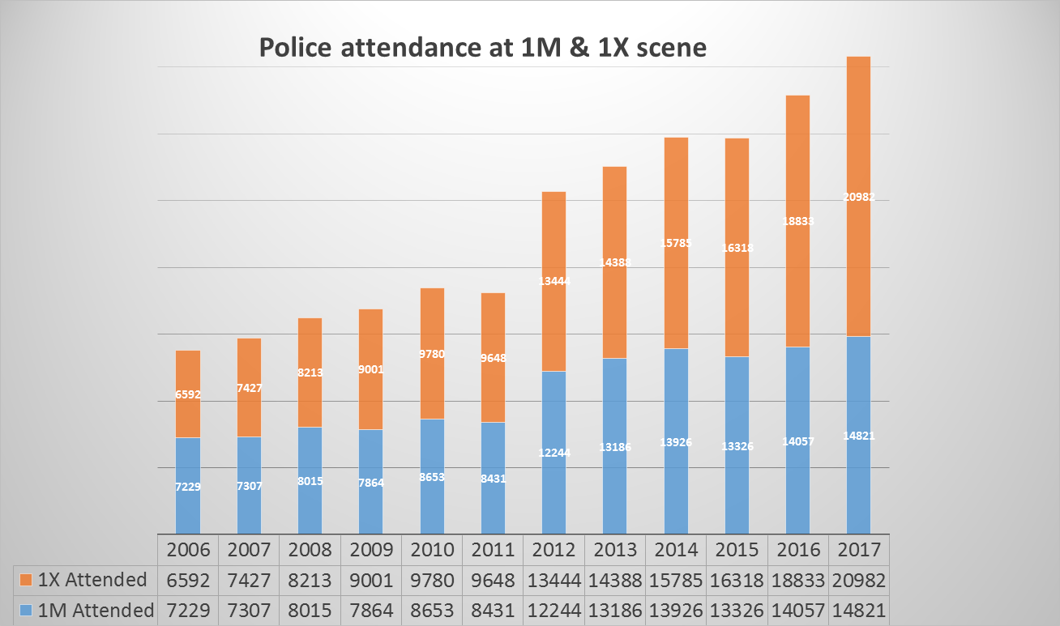
2. The NZ Police education programme

Slide 9
The STATS overview
35,803 combined 1M & 1X events in 2017 (NOTE: This is the number of events attended by police, and does not include calls.)
1M = Mental health related attendances.
1X = suicide-related attendances.
In 2017 this equates to 98 events every 24 hours - and this is climbing every year.
This is Forecast to be around 120 every 24 hours by 2019.
Nationwide this takes up an average of 274 hours of staff time every day.
In 77% of these events Police will be the ONLY agency on scene. (This % does not include 1X data at this time).

Slide 10
The NZ Police education programme
Revised Training Objectives:
Recognising mental distress
Engaging with people with experience of mental distress
Responding to people with experience of mental distress

Slide 11
The NZ Police education programme
Revised Programme (2018)
Additional new service user educators recruited and supported through training and facilitation
Workshops have been revised to include more service user engagement, scenarios & personal experience (positive and negative)
now being delivered to all Police recruits (total of approx. 2,000 over 3 years)
4 x 2-hour workshops are run monthly on the same day, facilitated by 3 service user educators
eLearning module for all Police trainees available from 2019
Tailored training for communications staff to be developed and delivered in 2019 (600 staff in total)
Advanced mental health training to be developed and delivered in 2020 (120)
Evaluation of workshops will inform future revisions
Individual interview data with recruit training and eLearning participants will be used to evaluate behavioural change

Slide 12
Cultural considerations
Key fact: “Māori are 3.3 times more likely to be apprehended for a criminal offence than non- Māori, 3.8 times more likely to be prosecuted than non- Māori and 3.9 times more likely than non- Māori to be convicted of an offence”
Quince, K. (2007) ‘Māori and the criminal justice system in New Zealand’, in J Tolmie and W Brookbanks (eds.), The New Zealand criminal justice system, LexisNexis, Auckland.
Notes:
Individual interpretation of the ‘language’ of mental health, mental illness and mental distress is reliant on the material and information provided and retained by those individuals.
In the context of Māori rates of arrest and conviction, and specifically avoiding negative outcomes for those experiencing mental distress and potential discrimination, the messaging is increasingly important for Māori to be offered support, hope and help where the likelihood of victimisation may continue to perpetuate discrimination.

Slide 13
Cultural considerations
What we want in terms of working with Māori:
Operate in accord to specific elements of the Māori worldview;
To acknowledge benefits for engagement of local Māori entities (i.e. iwi, NGOs. Services) that have purpose, objectives and vision to provide an indigenous health solution for Māori and their whānau with experience of mental illness and addiction.
These benefits include:
The potential to provide locally led Māori mental health solutions whilst ensuring easy access to services for Māori in their communities;
Provide further existing connections with local Māori, whānau, hapu and Iwi

Slide 14
Evaluation Summary YTD – April to Oct 2018….
During the initial term from April to Oct 2018, 28 workshops were delivered to an approximate total of 570 Police Recruits. A total of 498 evaluation forms were completed.
At the beginning of each workshop participants were asked to rate their current level of (low-expert) of their:
Understanding of recovery from mental distress
Ability to recognise mental distress
Ability to engage with people who have experience of mental distress
Confidence in responding to people with experience of mental distress
Their overall knowledge of the impact of stigma and discrimination on people with experience of mental distress
This Likert scale was repeated at the completion of the workshop.

Slide 15
Evaluation Summary YTD – April to Oct 2018….

Slide 16
Evaluation Summary YTD – April to Oct 2018….

Slide 17
Evaluation Summary YTD – April to Oct 2018….

Slide 18
Evaluation Summary YTD – April to Oct 2018….

Slide 19
Evaluation Summary YTD – April to Oct 2018….

Slide 20
Evaluation Summary YTD – April to Oct 2018….

Slide 21
Evaluation Summary YTD – April to Oct 2018….
Qualitative comments on Training:
Recruits see great value in the sharing of personal experiences, and general appreciation for the training overall.
Practical scenario sessions were valued and some felt more application of this would improve learning and emphasis on responding to those experiencing mental distress.
Some found the comprehensive detail in the session challenging due to the allotted time (2 hours).
Recruits expressed a need for more education on engaging local Services and types of Service, expectation from Service, etc.
Facilitators new to the Training programme have improved personable approaches with more experience with the recruits.

Slide 22
Questions….
Debs Craig
I was pleased to take up the opportunity to be a police trainer on mental distress in order to better equip police to apply empathy and understanding towards people experiencing acute mental distress, and hope that the training provides useful guidance on effective communication when involved in a 1M or a 1X callout.
A highlight has been the interest by recruits in the trainer’s personal stories of their interaction with the police (a mix of good and not so good experiences). The recruits and trainers really connect when these stories are told.
He waka eke noa… - A waka (journey) we are all apart of regardless…
Thank you

