Slide 1
Young kinship carers in Australia – a hidden group
Meredith Kiraly, PhD
Research Fellow
University of Melbourne
AIFS Conference Melbourne, July 2016

Slide 2
Sally and Erica

Slide 3
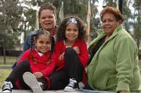
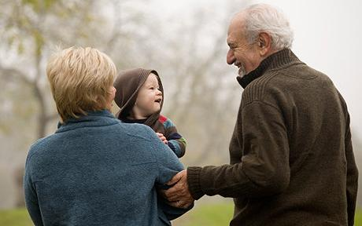
What is this about?
Demonstrating the existence of young kinship carers and their unmet support needs.
Busting the myth:
‘Kinship carers are grandparent carers’.

Slide 4
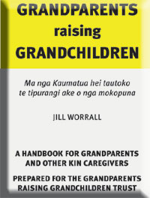
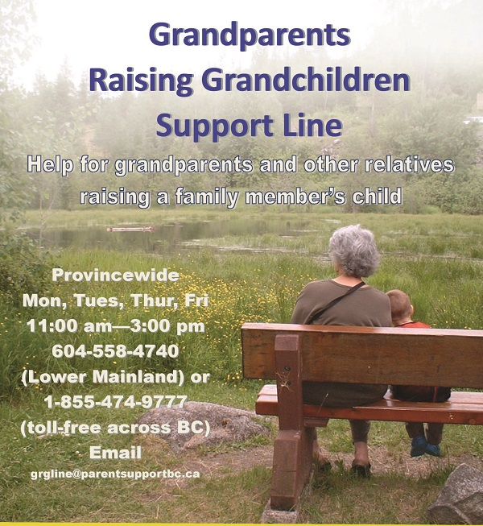
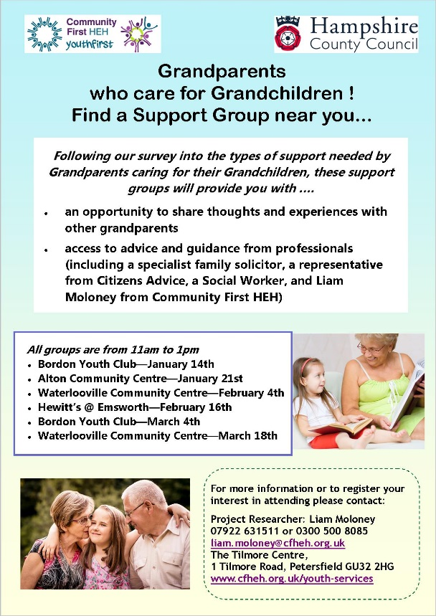
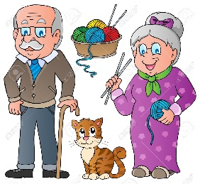
If you’re a grandparent raising grandchildren, you’re not alone. We can help you.
Notes:
Non-familial kinship care care bundled in with grandparent care with little consideration to how different it might be.

Slide 5
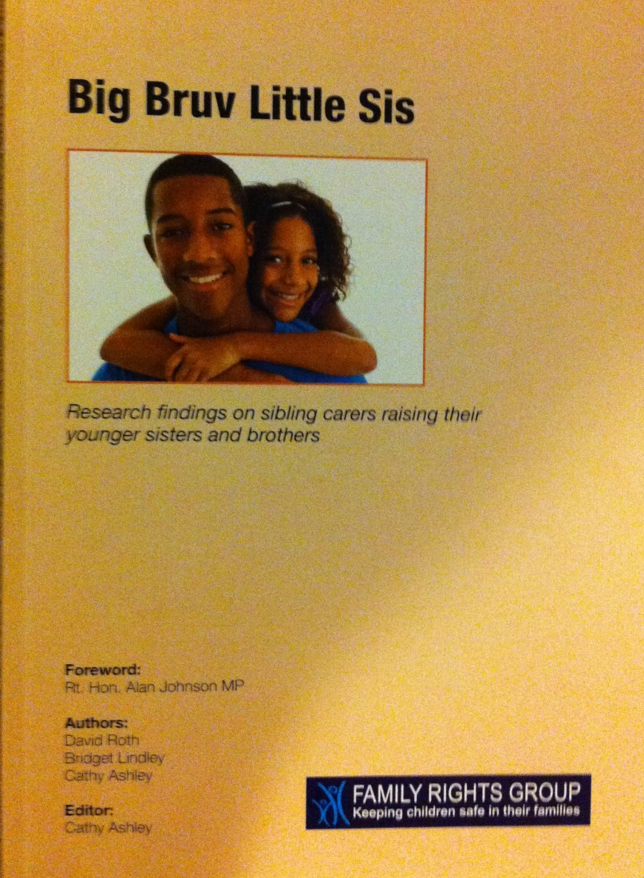
UK research
38% of children in kinship care in England were being cared for by a sibling carer without help from older household member.

Slide 6
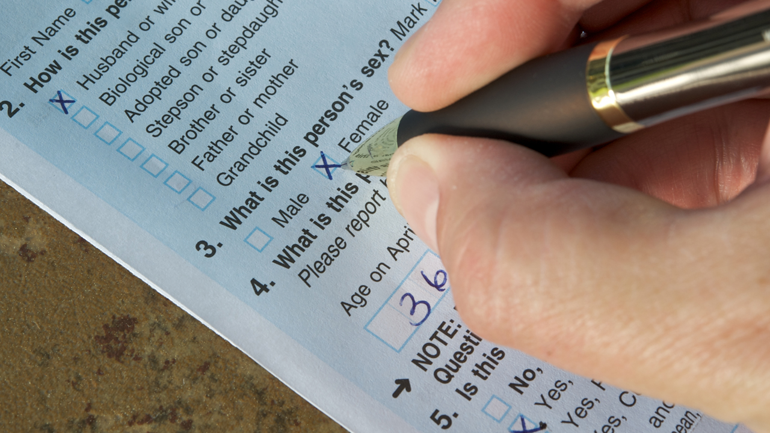

Slide 7
The facts
2011 Census data: kinship carer households (Two-generation)
TIP of the iceberg: up to 8 times as many in
three-generation families
Age of Household Reference Person | 25- | 30- | 60+ | 65+
Total households in age range | 7,000+ | Just under 10,000 | ∼14,000 | ∼8,500

Slide 8
Young and ‘care-full’: The support needs of young kinship carers and children in their care
Aim: To provide information about the experiences and needs of young kinship carers with a view to improving service responses.

Slide 9
Methodology
Census analysis: income/employment, education, partnering
Survey
In-depth interviews
Pilot online support
Knowledge dissemination & advocacy

Slide 10
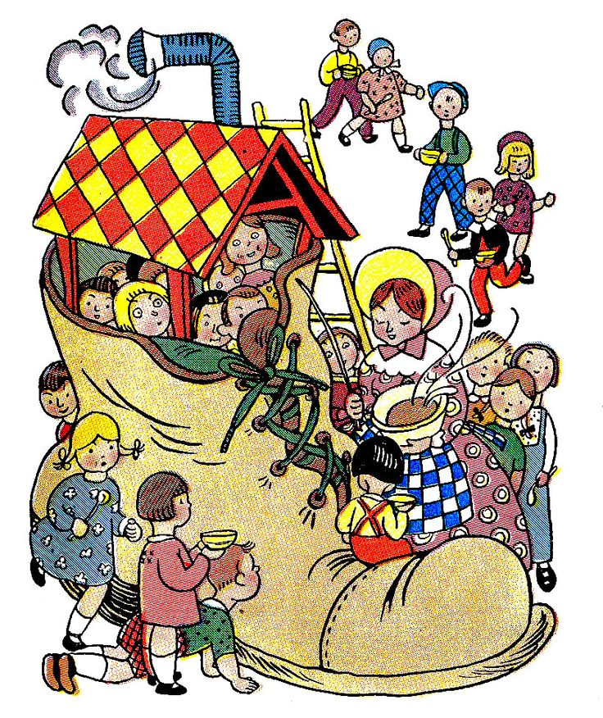
Aunt and Uncle

Slide 11
Anna and Dave
Anna, 27, studying Teaching – deferred.
Dave, Welfare Officer; second job Ambulance Service.
Two children together: Tina, 4, and Rawson, 2.
Niece Tilly, 2, & nephew Jackson, 16 months, 6th & 7th children of Dave’s sister (both came as newborns); both with physical health issues/developmental delay.
Anna’s son Aron, 11, and Dave’s daughter Ellie, 7, visit.
The 5 siblings are in other parts of their families.

Slide 12
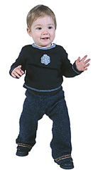
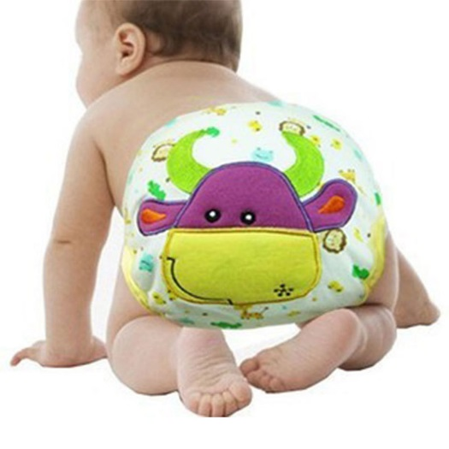
‘The hardest things?’

Slide 13
Social support

Slide 14
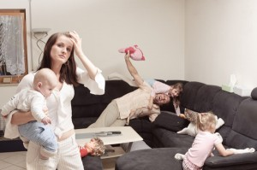
Support services lacking…

Slide 15
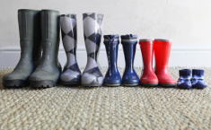
Elder sister

Slide 16
Rosie and Damien
Rosie, 27, interior decorator; studying Certificate IV by distance education: studies currently on hold.
Damien: pilates instructor; some daytime at home.
Two children:
Ruby, 10, autistic, disability allowance
Jack, 3, asthmatic.
Finn, 10, Rosie’s brother; also cared for brother Tyson, now 14, before care arrangement broke down.
Mother has bipolar disorder; disturbed behaviour.

Slide 17
Supervising mother’s visits…

Slide 18
Where are we up to?
Census analysis: income/employment, education, partnering
Survey
Interviews
Pilot online support program
First publication:
‘We’re quite capable, we just need support’: the circumstances of young kinship carers

Slide 19
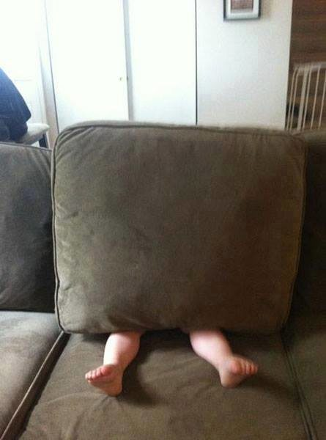
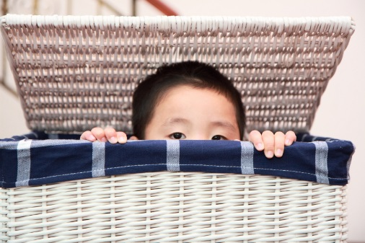
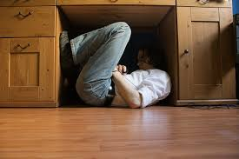
Finding a hidden group

Slide 20
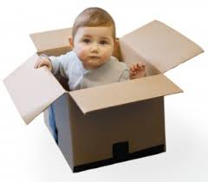
‘We’re quite capable, we just need support’
‘We’re not incapable – so don’t look at the age. I was lucky because I do have that support; and a lot of these kids that aren’t doing too well they could be great as well if you gave them that help. If you told them where to go they could do it.’
(Frances, 18 years)

Slide 21
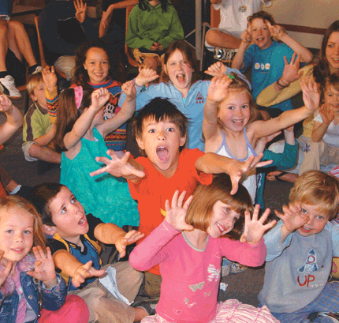
More information?
Meredith Kiraly
mkiraly@unimelb.edu.au
0400 913 659
Ideas and assistance welcome!

Slide 22
References
Kiraly M and Humphreys, C. (2016) ‘We’re quite capable, we just need support’: the circumstances of young kinship carers. Journal article submitted for review May 2016.
Roth, D., Lindley, B., & Ashley, C. (2011). Big Bruv Little Sis: Research findings on sibling carers raising their younger sisters and brothers. London: Family Rights Group.
Selwyn, J. & Nandy, S. (2012). Sibling kinship carers in England: Evidence from the 2001 population census. Children and Youth Services Review, 34(1), 194-199.
Social Policy Research Centre. (2011). Young carers: Social policy impacts of the caring responsibilities of children and young adults, Final Report. … Sydney: University of New South Wales.

